Slide 1
WhyteSyght
By Psifrous

Slide 2
Team:
E17CSE120 E17CSE179 E17CSE071
Ambuje Gupta Naman Bansal Harsh Kataria
(Bennett University)

Slide 3

Mission:
To make lives better through code

Slide 4


The problem
The visually challenged face problems in their day to day tasks.
To create a technological solution to ease away some of their problem.

Slide 5

260 million visually impaired people of 7.3 billion people

Slide 6

The solution
SOUND!
“Using computer vision to detect the surrounding environment and relay the same via sound”

Slide 7
How?
The different functionalities of our project
Scene Detection
Action Detection
Support
Environment scanning for 90 common objects and people
Action recognition for the current frame
Emergency support with live guidance from a third party
 |  |  |  |  | WhyteSyght

Slide 8
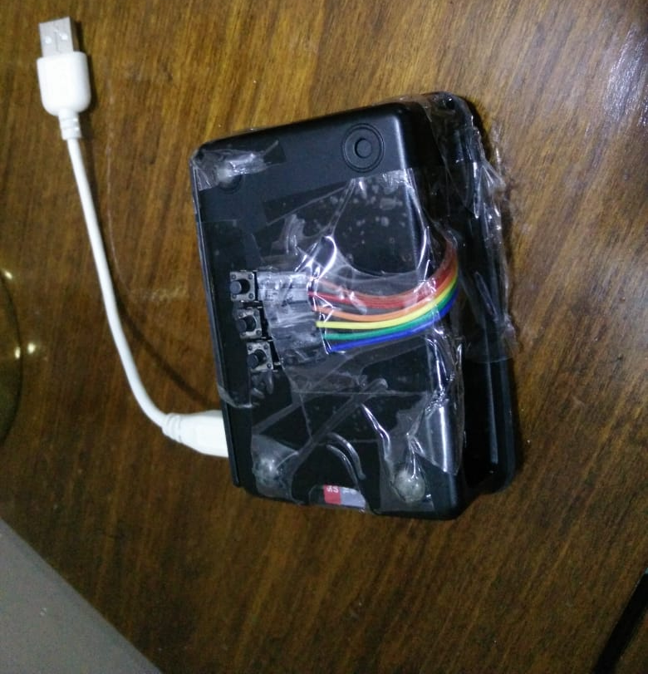
Scene Detection
Hardware
Emergency / Live Stream
Action Detection

Slide 9
Input frames from head-mounted camera
Design and Implementation
Detection of actions/objects using computer vision
Output in the form of speech

Slide 10
Technologies used
Raspberry Pi
Web Cam
TensorFlow
OpenCv
Python 3.5

Slide 11

Due to such rapid evolvement in the domain of machine learning and AI, such technologies have been available to the masses at large.
Hence we were able to produce a solution which can be available to all easily
Why now?

Slide 12
Challenges Faced
Training action detection algorithm in a such a short time and getting its accuracy so that its usable
Syncing hardware buttons with software so that a smooth process is enabled
Keeping the product as simple as possible while not losing on any basics that is keeping the product simple so that it is easily used by a blind person and keeping features so that it helps him/her in his daily routine.

Slide 13
The team
Answer the question, “Why are we the ones to solve the problem we identified?”
Contribution of each team member
Ambuje Gupta: Using MQTT protocol to integrate physical buttons & setting up protocol for live stream using Nginx engine
Harsh Kataria: Action Recognition using TensorFlow and OpenCV
Naman Bansal: Scene Detection using TensorFlow and OpenCV

